Slide 1
Unit – II
Time domain analysis: Standard test signals – step, ramp, parabolic and impulse response function – characteristic polynomial and characteristic equations of feedback systems – transient response of first order and second order systems to standard test signals. Time domain specifications - steady state response – steady state error and error constants. Effect of adding poles and zeros on over shoot, rise time, band width – dominant poles of transfer functions.
Stability analysis in the complex plane: Absolute, relative, conditional, bounded input –bounded output, zero input stability, conditions for stability, Routh –Hurwitz criterion.

Slide 2
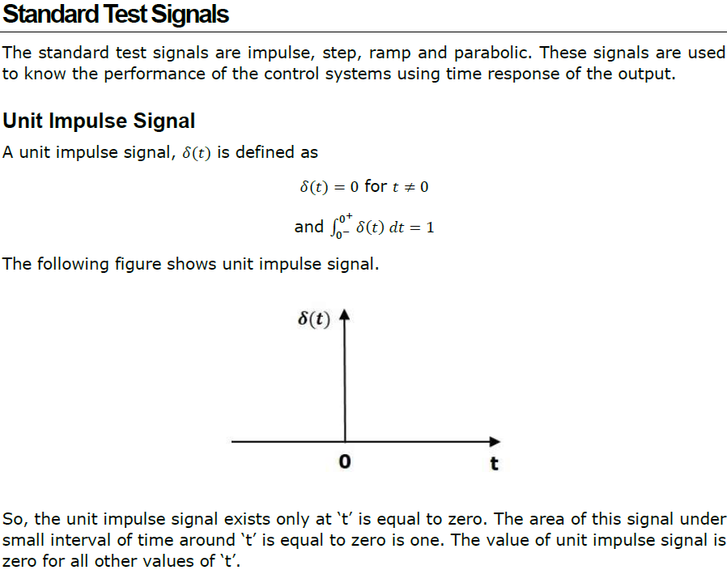

Slide 3
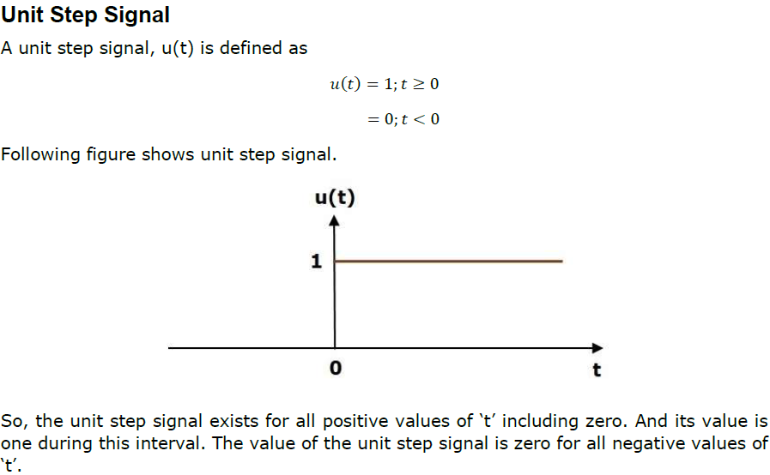

Slide 4
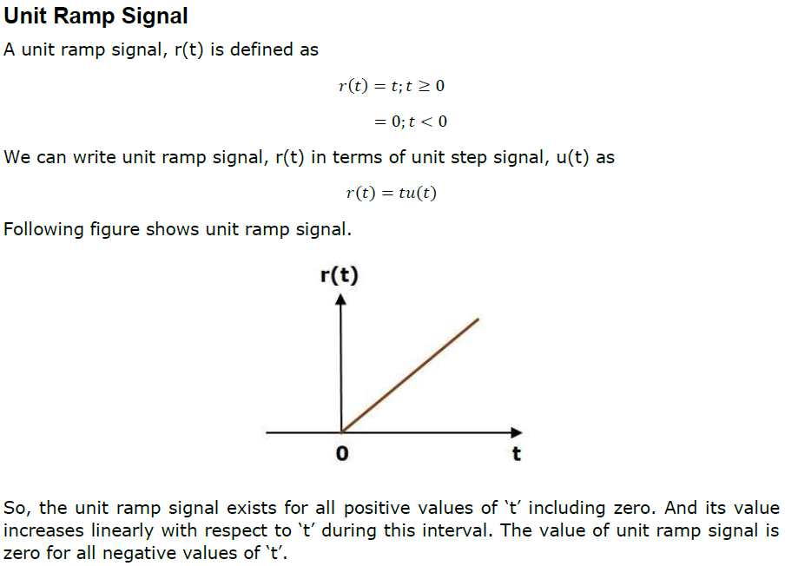

Slide 5
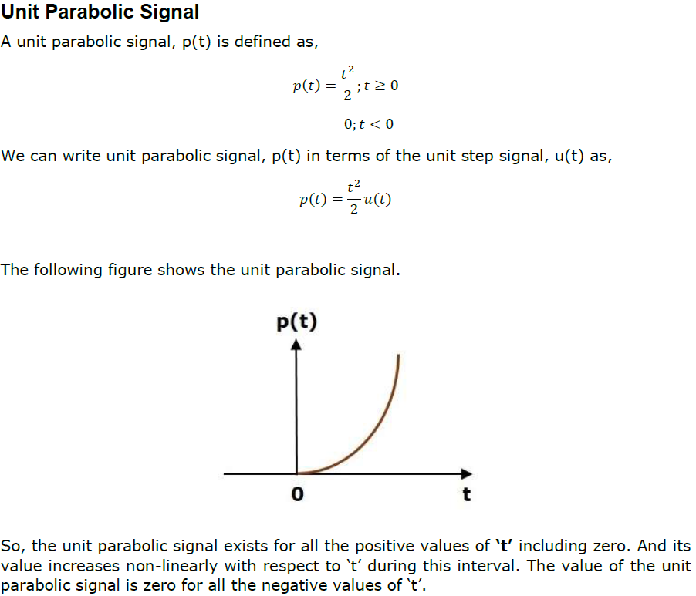

Slide 6






Laplace Transform Theory
General Theory
Example
Convergence

Slide 7
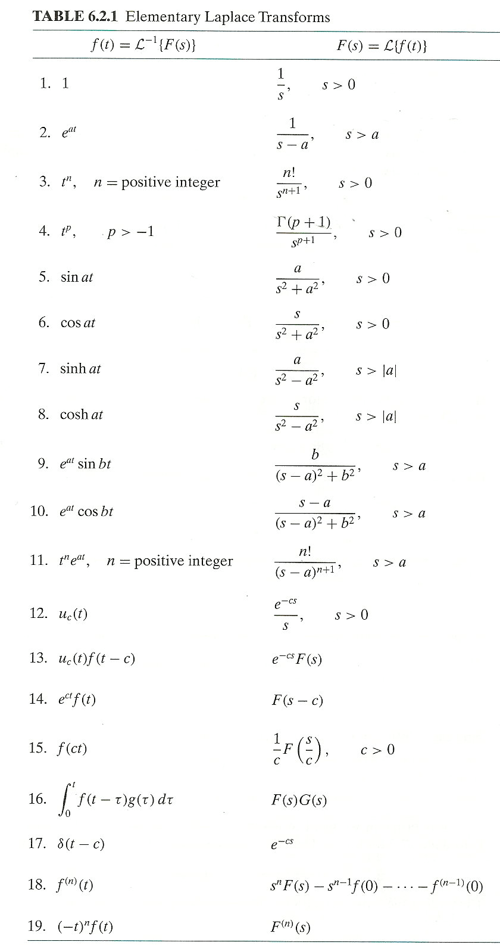

Laplace Transforms
Some Laplace Transforms
Wide variety of function can be transformed
Inverse Transform
Often requires partial fractions or other manipulation to find a form that is easy to apply the inverse

Slide 8





Laplace Transform for ODEs
Equation with initial conditions
Laplace transform is linear
Apply derivative formula
Rearrange
Take the inverse

Slide 9
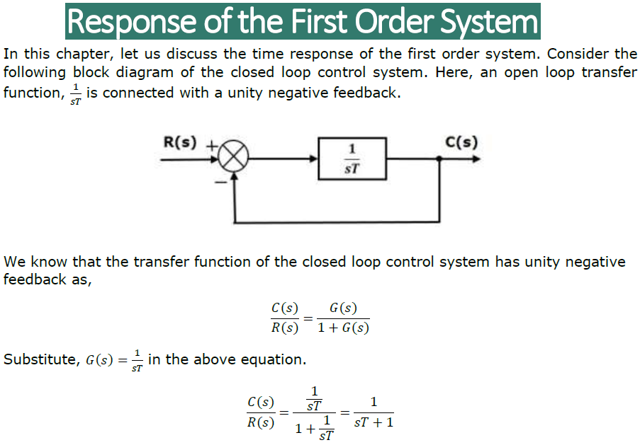

Slide 10
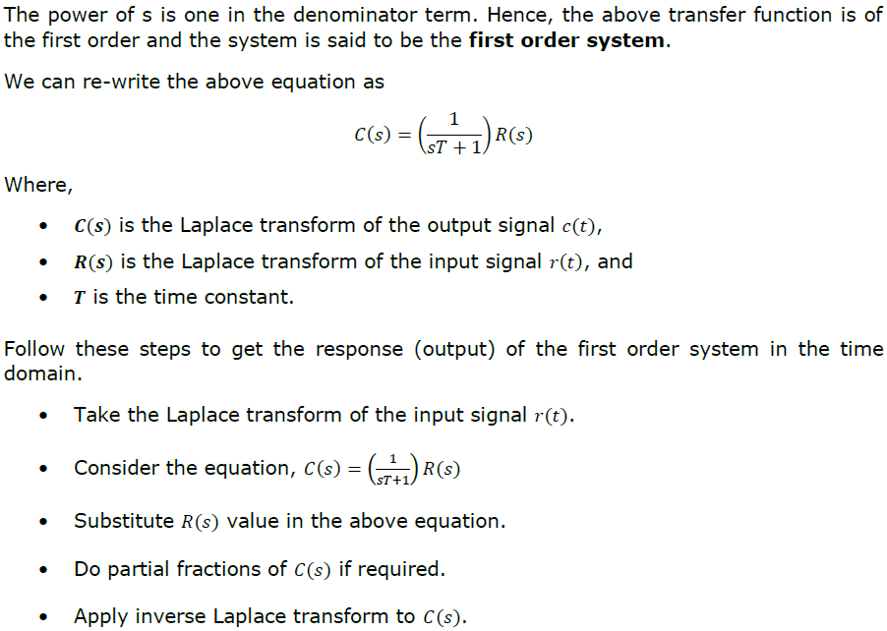

Slide 11
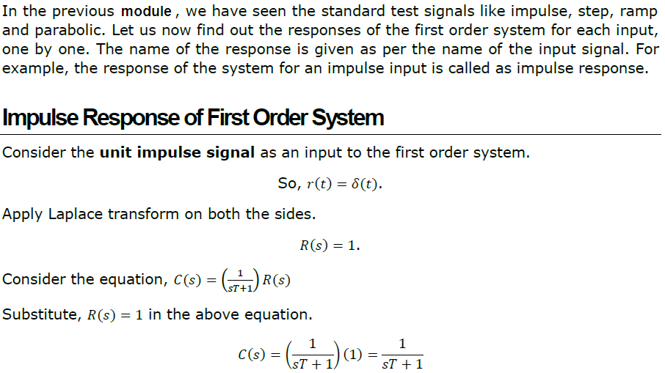

Slide 12
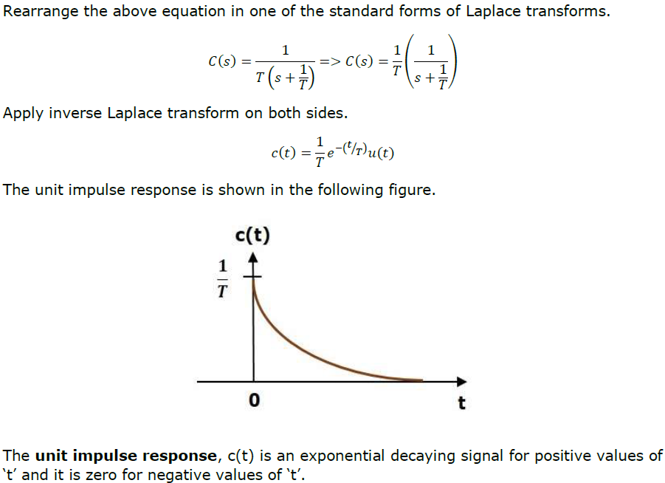

Slide 13
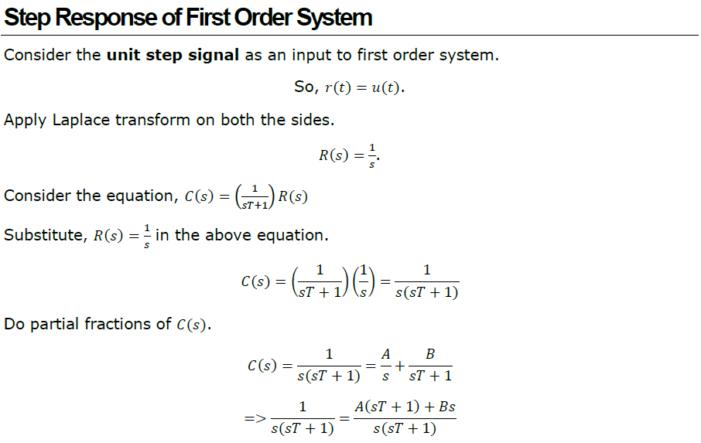

Slide 14
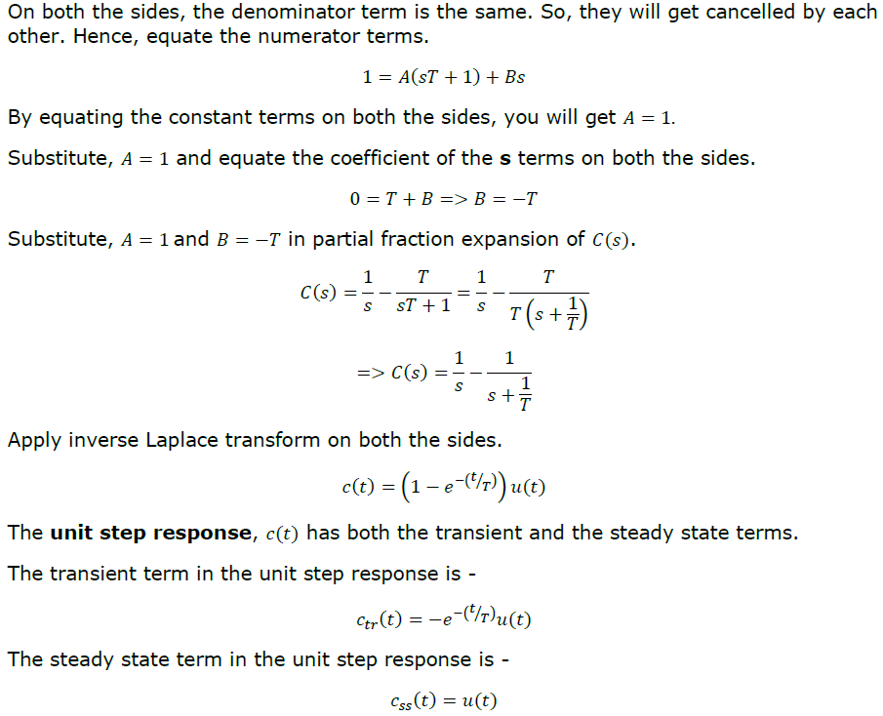

Slide 15
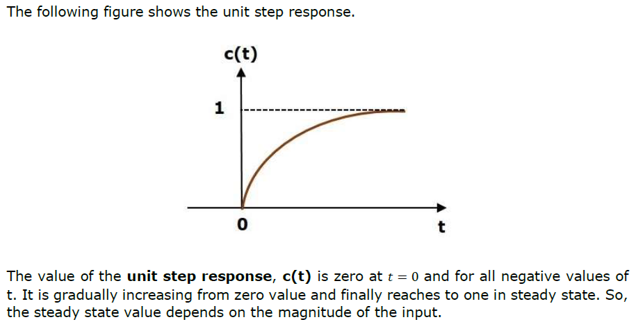

Slide 16
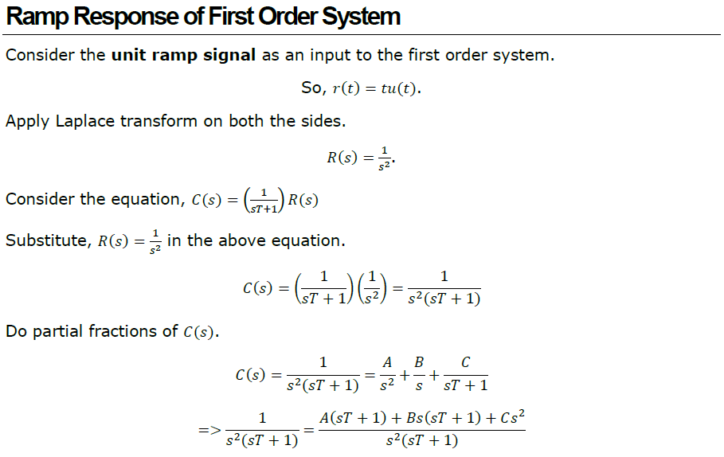

Slide 17
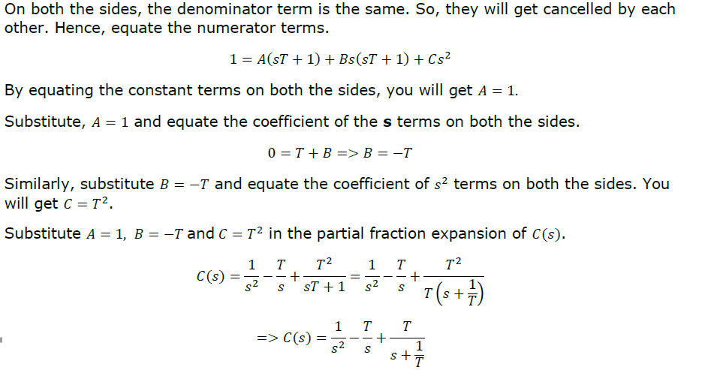

Slide 18
